Slide 1


DIGITAL PORTFOLIO
Name: Ruthab Fathima.v.m
Register number and NM Id : 31224U50035 and
03E6A10F4A2F85ABC5744E2443734479
Department : B.sc.Artificial Intelligence
College and university : Islamiah women’s arts and
science College, thiruvalluvar University

Slide 2
PROJECT TITLE
Interactive Digital Portfolio using Front End Web Development

Slide 3
1.Problem statement
2.Project overview
3.End Users
4.Tools and Technologies
5.portfolio design and layout
6.features and functionality
7.Results and screen shots
8.conclusion
9.Github Link
AGENDA

Slide 4
PROBLEM STATEMENT
Traditional resumes and paper-based portfolios lack interactivity and engagement, making it difficult for students to showcase their skills, projects, and achievements effectively. With increasing demand for digital presence, there is a need for an interactive, web-based student portfolio that highlights personal details, education, skills, and projects in a professional and user-friendly way.

Slide 5
PROJECT OVERVIEW
A personal portfolio website for students
Built with HTML, CSS, JavaScript
Showcases education, skills, projects, hobbies, and contact
Responsive, user-friendly, and visually appealing

Slide 6
WHO ARE THE END USERS
Students (for career & academics)
Teachers & Mentors
Recruiters & Employers
Project Collaborators & peers

Slide 7
TOOLS AND TECHNIQUES
Frontend: HTML, CSS, JavaScript
Design: Canva / presentation
Version Control: GitHub
Hosting: GitHub Pages / Netlify

Slide 8
PORTFOLIO DESIGN AND LAYOUT
Header & Navigation bar
Sections: About, Education, Skills, Projects, Hobbies, Contact
Smooth scrolling & highlights
Responsive mobile-friendly design

Slide 9
FEATURES AND FUNCTIONALITY
Smooth scrolling & section highlighting
Responsive design (desktop & mobile)
Interactive navigation bar
Contact links with email & phone
Project showcases with cards

Slide 10
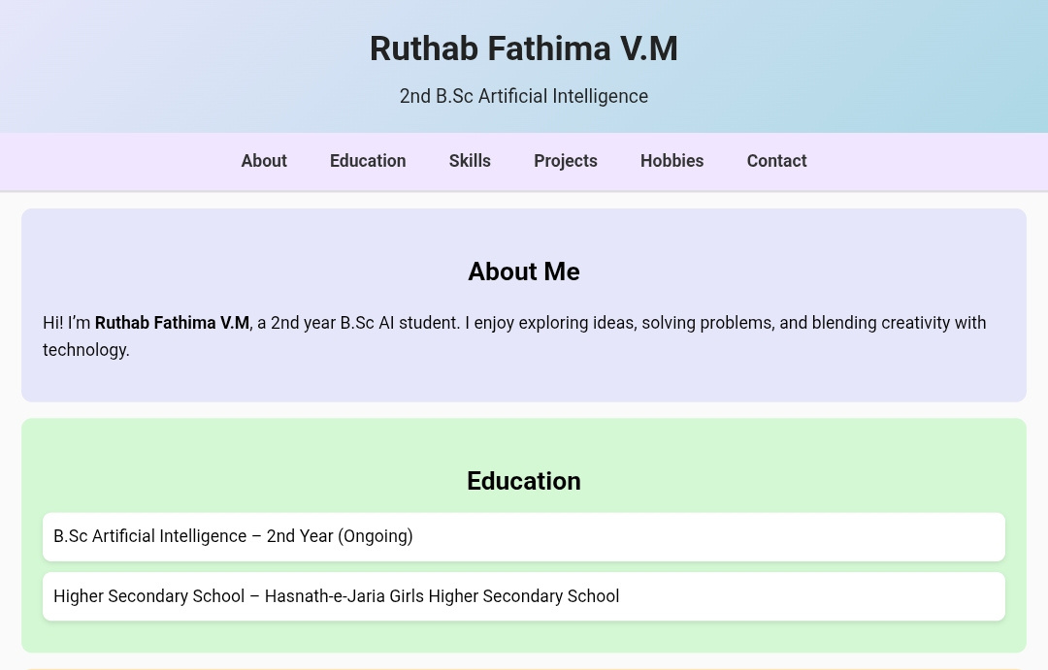
RESULTS AND SCREENSHOTS

Slide 11
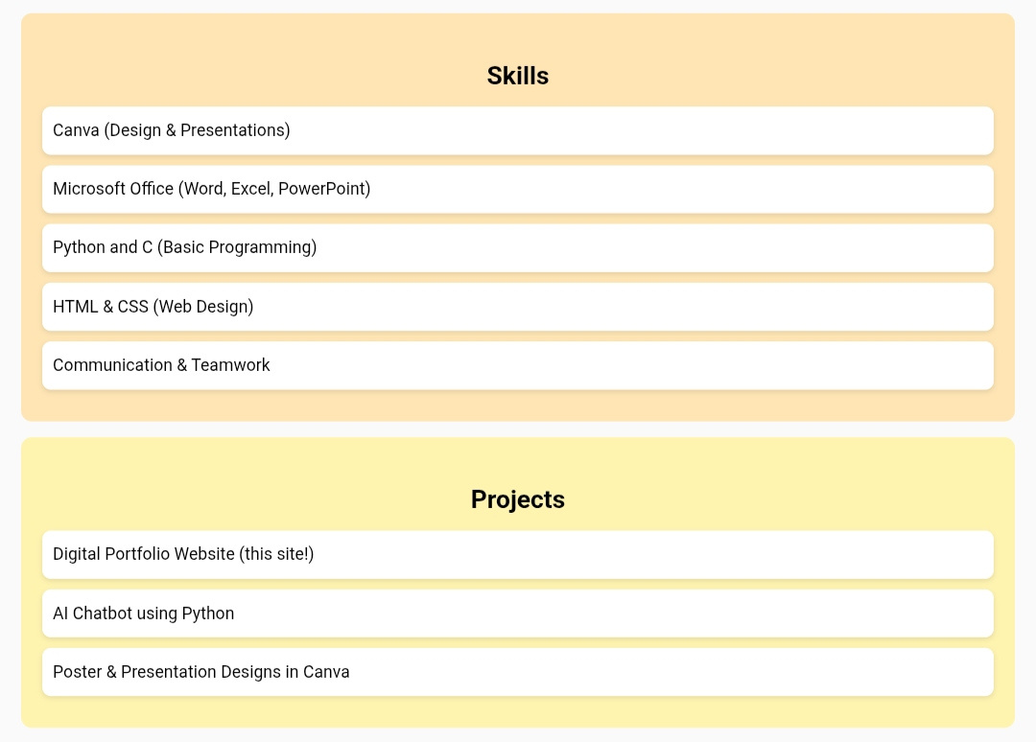
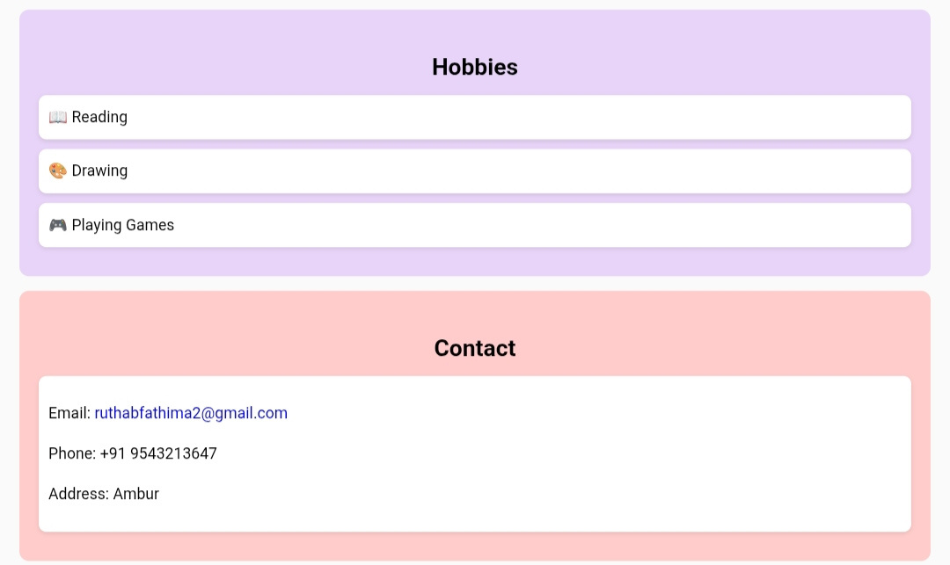

Slide 12
CONCLUSION
Interactive portfolios improve student visibility
Professional way to showcase projects & skills
User-friendly and accessible from anywhere
Future scope: add backend integration & AI features

